Slide 1
IDEA Speaker Series: Building employer capacity for disability inclusion through knowledge to practice
RG
Building Employer Capacity for Disability Inclusion through Knowledge to Practice
November 24th, 2023
IDEA Speaker Series
Emile Tompa Rebecca Gewurtz
ETompa@iwh.on.ca Gewurtz@mcmaster.ca

Slide 2
Land Acknowledgement
RG
Where we are currently meeting has, for thousands of years, been the traditional land of the Huron-Wendat, the Seneca and, most recently, the Mississaugas of the Credit River. Today, this land is still home to many Indigenous people from across Turtle Island, and we are grateful to have the opportunity to conduct our work on it.
Please note that this acknowledgement is relevant to the Toronto area, however, since we are coming together from different places across Turtle Island, we suggest thinking of the communities in your respective locations as well.
www.vraie-idea.ca

Slide 3
Agenda
RG
Introduction to the Webinar Series (10 mins)
Brief overview of IDEA (10 mins)
Deep Dive into Projects in Hub 1 and 2 (15 mins)
Q & A, Discussion (20 mins)
Wrap-up (5 mins)
www.vraie-idea.ca

Slide 4
Overview of IDEA
ET
IDEA is a knowledge-to-practice social innovation laboratory funded by the New Frontiers in Research Fund Transformation Stream
We focus on advancing the skills and capacities of workplace stakeholders in the area of inclusive employment
We are transdisciplinary, partner driven, and solution focused
We develop evidence-informed products that support inclusive workplaces
We base most of our work on existing knowledge bases, including initiatives that are already successful in the workplace
www.vraie-idea.ca

Slide 5
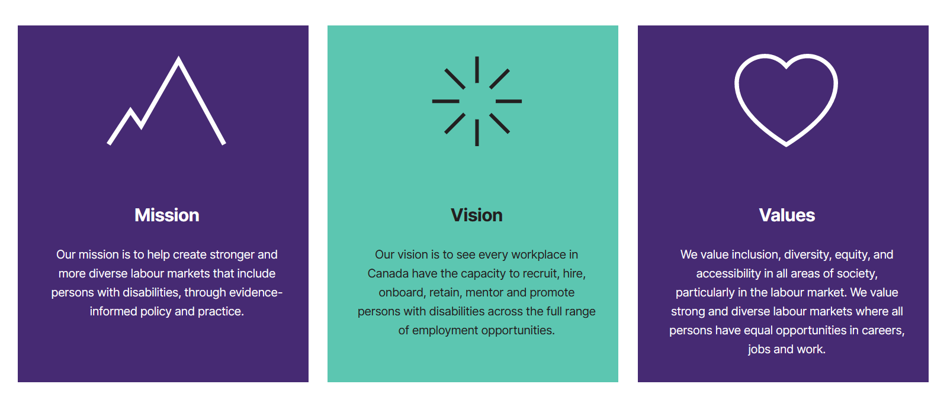
Mission, Vision, Values
ET
www.vraie-idea.ca

Slide 6
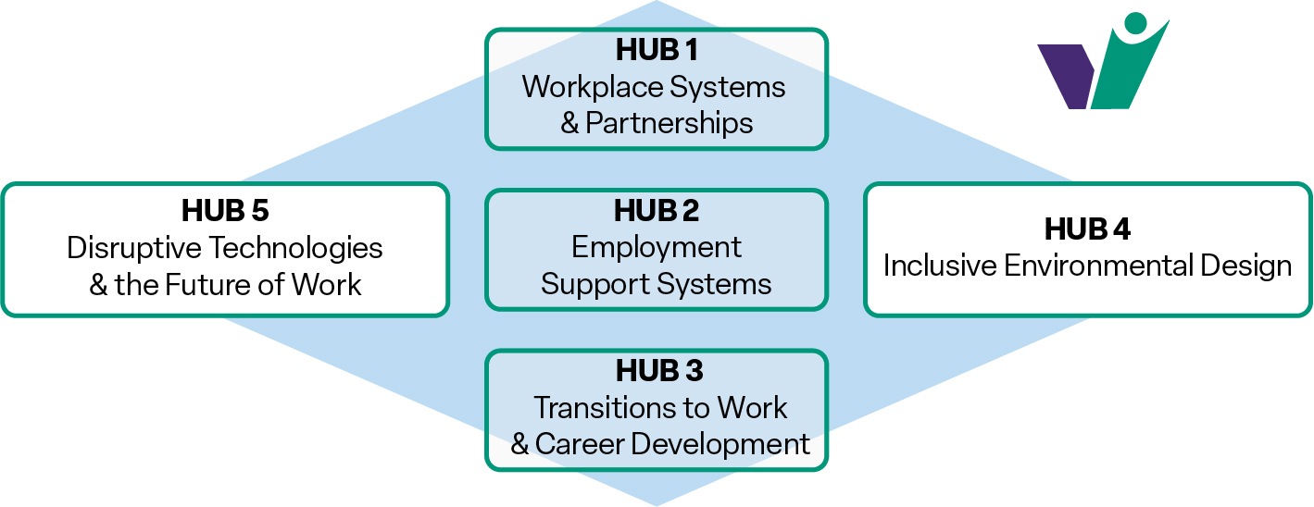
Our Approach
ET
Focus on organizational/demand-side capacity building
Multi-disciplinary, multi-sectoral, partner-driven social innovation laboratory
Incubator hubs, co-led by a researcher and partner representative, serve as entry points for inquiry
www.vraie-idea.ca

Slide 7
IDEA Signature Methodology
ET
IDEA Signature Methodology
Knowledge to Practice
www.vraie-idea.ca

Slide 8
Partner Organizations
ET
Partner Organizations
Research
McMaster University
Carleton University, READ Initiative
Centre for Research on Work Disability Policy (CRWDP)
Cornell University, Institute on Employment and Disability
Institute for Work and Health (IWH)
Lakehead University
OCAD University, Inclusive Design Research Centre Ottawa Hospital Research Institute, Centre for Implementation Research
Toronto Metropolitan University
Saint Mary's University
State University of New York in Buffalo, Research Center for Inclusive Design and Environmental Access
University of Melbourne, Melbourne Disability Institute
Université de Montréal
Université du Québec à Montréal
Université de Sherbrooke
University of Sydney, Centre for Disability Research and Policy
University of Tokyo, Research Center for Advanced Science and Technology
University of Toronto, Centre for Industrial Relations and Human Resources
University of Western Ontario
University of Winnipeg
York University
Disability Communities
Canadian National Institute for the Blind (CNIB)
Inclusion Canada
National Educational Association of Disabled Students (NEADS)
Realize
Labour
Ontario Federation of Labour (OFL)
Ontario Secondary School Teachers’ Federation (OSSTF)
Canadian Labour Congress (CLC)
UNIFOR
Provincial Building & Construction Trades Council of Ontario
United Food and Commercial Workers Canada (UFCW)
Industry
Automotive Parts Manufacturers’ Association
Canadian Chamber of Commerce
Canadian Imperial Bank of Commerce (CIBC)
Jazz Aviation
Services
L’Arrimage
Canadian Council on Rehabilitation and Work (CCRW)
March of Dimes, Rehabilitation and Clinical Services
Ontario Occupational Health Nurses Association
Ready, Willing and Able
Government
Accessibility Standards Canada
Employment and Social Development Canada
Labour Market Information Council

Slide 9


Partner Organization Logos
ET

Slide 10
Hub 1 Projects – Workplace Systems and Partnerships
ET
Best practice for accessibility planning and reporting
OFL Inclusive Design Workshop
Scan of promising practices in industry
Taking a disability lens in procurement and the supply chain
www.vraie-idea.ca

Slide 11

Best Practices for Accessibility Planning and Reporting
ET
Key concept: Disability Confidence
This describes the confidence that workplace parties – employer and union – have in their capacity to fully include persons with disabilities in the workplace.
A disability confident workplace puts policies into practice to ensure persons with disabilities are included, belong and do not have barriers to employment or promotion.
www.vraie-idea.ca
Notes:
Part of the IDEA project is to develop tools to help workplace parties assess their disability confidence, just as we assess the true health and safety conditions in a workplace.

Slide 12
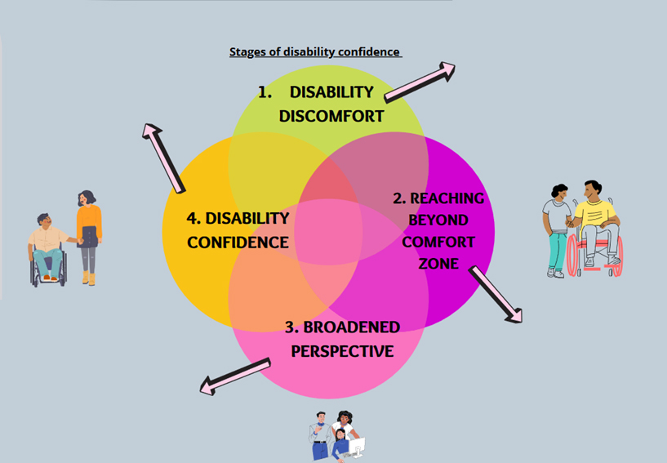
Stages of Disability Confidence
ET
Supportive and inclusive work culture
Organization is leading social change
Building employment and tools that display and support skills
Involves stigma and discomfort because of a lack of knowledge
People are uncomfortable around disability and judge more harshly than those without disabilities
Involves disability awareness training to improve workplace culture by changing mindset
Shared lived experiences that help break down stereotypes
Business case for hiring and retaining persons with disabilities, they are innovative, problem solvers, and have a strong work ethic
Challenges stigma and stereotypes
Minimizes bias and focuses on abilities
Values the talents and potential persons with disabilities have instead of hiring for company image
Does not focus on nature of the condition
Lindsay, S., Leck, J., Shen, W., Cagliostro, E., & Stinson, J. (2019). A framework for developing employer’s disability confidence. Equality, Diversity and Inclusion: An International Journal, 38(1), 40–55. https://doi.org/10.1108/edi-05-2018-0085
https://hollandbloorview.ca/sites/default/files/A%20Framework%20for%20Developing%20Employer%27s%20Disability%20Confidence.pdf

Slide 13
Key Concept: Equity Diversity Inclusion and Accessibility (EDIA) Maturity
ET
Best Practices for Accessibility Planning and Reporting
Like disability confidence but includes all equity deserving groups and the journey that an organization takes to become a leader
Five stage model – 1) aware, 2) compliant, 3) tactical, 4) integrated, 5) sustainable
EDIA maturity may vary in different aspects of an organization’s areas of activity (e.g., human resources, procurement, communications, technology use, customer/client/community relations)
www.vraie-idea.ca

Slide 14
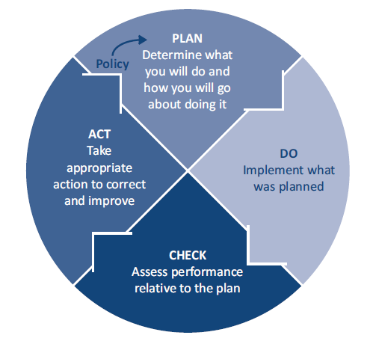
Best Practices for Accessibility Planning and Reporting: Continual Improvement
ET
Key Concept: Continual Improvement
The process of enhancing a system to achieve ongoing improvement in targeted areas of activity and desired outcomes
In workplace systems it is often associated with the framework of plan-do-check-act (PDCA)
www.vraie-idea.ca

Slide 15
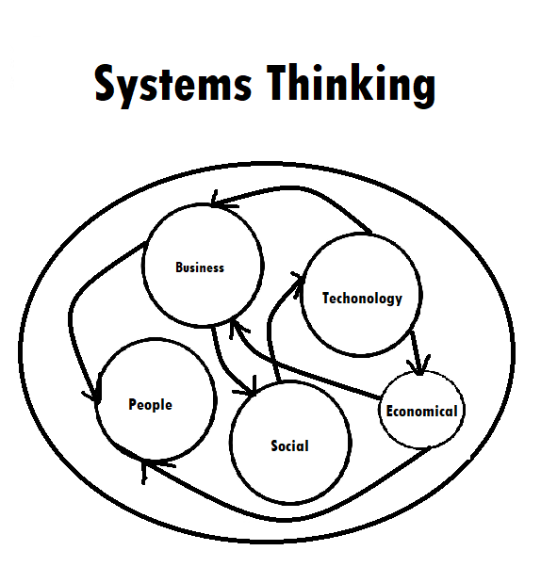
Best Practices for Accessibility Planning and Reporting: Systems Thinking
ET
Key Concept: Systems Thinking
Systems thinking is a way of making sense of the complexity of the world by looking at it in terms of wholes and relationships rather than by splitting it down into its parts.
It is used to exploring and developing effective action in complex contexts, enabling systems change.
Systems thinking is a holistic way to investigate factors and interactions that could contribute to a possible outcome
Systems thinking is a comprehensive approach to introducing organizational change and development to create a new normal at the systems level.

Slide 16
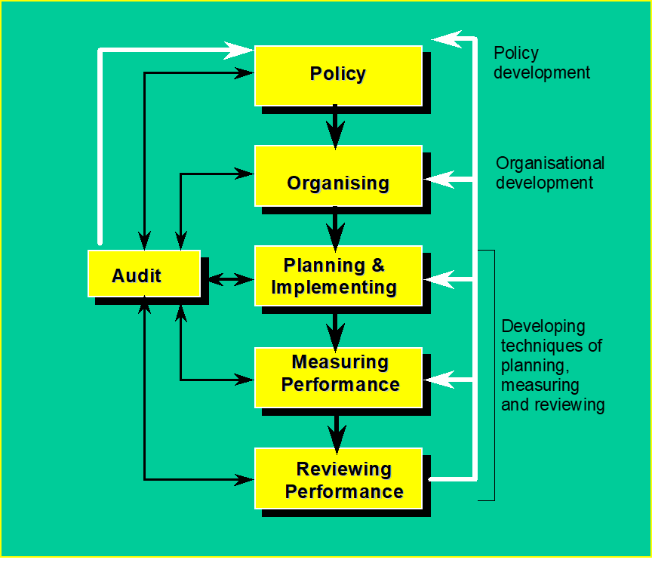
Combining Systems Thinking with
Continual Improvement
ET
Continual Improvement in Workplace Systems
Policies play a fundamental role in setting clear directions for organizations to follows
Organizational structures need to be in place to deliver on policies
Requires a planned and systematic approach to implementing policies
Emphasis is given to measurement of performance against targets to identify needed improvements
Reviews and learning from experiences are fundamental to continual improvement
UK Health and Safety Executive (HSG65) https://www.hse.gov.uk/pubns/priced/hsg65.pdf

Slide 17
Accessibility Planning and Reporting
A Five-step Framework for Action
ET
Identify core areas that need to be address (compliance)
Include other areas of strategic importance for the organization (tactical)
Create mix teams of workplace actors to address each area, complete scans/audits and identify gaps, develop an action plan with short and long-term targets, implement plans, ensure open reporting
Plan for an EDIA lens in all areas of organizational activities (integrated)
Institutionalize continual improvement in the planning process across all areas of the organization (sustainable)
www.vraie-idea.ca

Slide 18
Inclusive Design Workshop Development Partnership with OFL
ET
Objective: To develop and deliver a customized workshop on inclusive design focused on creating more accessible and inclusive workplaces.
Approach: Train-the-Trainer
Target Audiences:
Initially for labour leaders and activists
Ultimately also for employers, including senior management, supervisors and managers, and human resource specialists
Ideally these would be joint union/management sessions
www.vraie-idea.ca

Slide 19
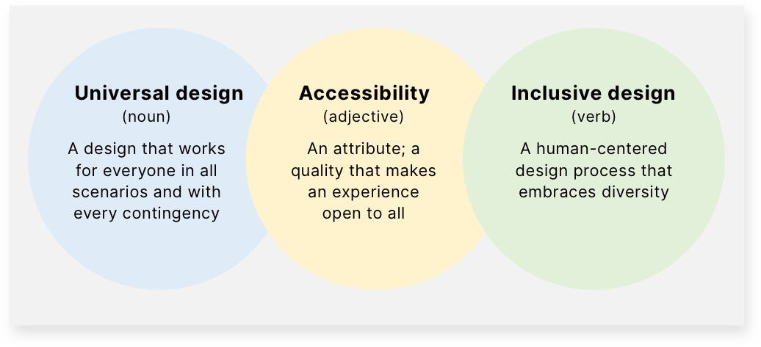
Universal Design, Accessibility, and Inclusive Design
ET
https://uxplanet.org/designing-for-humanity-going-beyond-accessibility-to-create-inclusive-designs-709fb791c145

Slide 20
Workshop Modules
ET
Best practices in recruitment, hiring and onboarding of diverse workers.
Essential skills for inclusive mentorship, coaching and advancement.
The role of the union in supporting an inclusive workplace.
Beyond the built environment—creating inclusive work environments.
Flexible work arrangements and virtual work.
Inclusive design in information and communication technologies (ICT).
Implementing a robust disability prevention system by maximizing accommodation and inclusion.
Weaving inclusive design and accessibility into procurement and the supply chain.
Accessibility planning, reporting and a roadmap for change.
Ensuring plans are implemented and improved over time—through measurement, audits and assessment tools (such as worker surveys).
www.vraie-idea.ca

Slide 21
Hub 2 Projects – Employment Support Systems
RG
Best practices in the use of remote work as an accommodation
Identifying and evaluating approaches to employment supports and what employers need to create inclusive workplaces
Identifying and evaluating the wrap-around supports that people need to be successful at work
Exploring intersecting issues of disability, gender, and race within employment support services
www.vraie-idea.ca

Slide 22
Featuring Key Innovations in Employment Supports
Scoping review and environmental scan of existing literature and existing practices for building employer capacity
Scoping review and key informant interviews about supporting disabled job candidates from racialized groups and the experiences of racialized disabled job candidates within employment support services
Working to evaluate existing innovations to showcase some effective models that might work with particular populations
  Example – embedding an OT on an employment team to better meet the needs of people with mental illness in Hamilton

Slide 23
Remote Work Scan
10 Databases: MEDLINE, CINAHL, EMBASE, Web of Science, Sociological Abstracts, ASSIA, PsycInfo, Business Source Premier, EconLit, Proquest One Business
Summary
24143 abstracts
20580 screened
447 Full-text
89 included in the review

Slide 24
Initial Findings from Remote Work Project
Mostly from USA and Europe – very little in the Canadian context
Mostly grey literature (41 papers) but some studies
Little exploration of intersectional identities
Job sector varies but mostly not specified
A range of terminology and arrangements
A range of implications but largely framed as positive; the exception is access to technological needs or adaptive equipment

Slide 25
Next Steps for Remote Work
An online survey and key informant consultations to better understand the impact of remote work on the experiences of people with disabilities

Slide 26
Deliverables from Hub 2
RG
Summary of existing supports for employers and existing evidence
Recommendations for service providers and policy decision-makers/funders
Showcase of different models of building capacity within employment supports
Guidance document – plain language summary with recommendations
Policy briefing – how can we support employers to hire and accommodate people with disabilities?

Slide 27




Thank You!!
Stay in touch: www.vraie-idea.ca

